Slide 1

ImmoEliza ML: Real Estate Price Prediction in Belgium
Capuccino presents a machine learning solution for accurate real estate price prediction in the Belgian market. Our model combines advanced algorithms with comprehensive property data to deliver reliable valuation estimates for data scientists and property analysts.

Slide 2
Data Preprocessing: Building a Clean Foundation
Worked on 2 different datasets:
Feature Engineering
Data Cleaning
Encoded categorical variables (property type, subtype, EPC rating, building condition, etc.) using one hot encoding and targeted numerical mapping for interpretability and model efficiency.
Removed duplicate listings and statistical outliers using the IQR filter (properties outside 1.5×IQR from the median).
First with 70211 rows and 21 features
Merged columns (inside and outside parking) to keep the maximum information from the data
Second with 56005 rows and 14 features
Identified and handled missing values through imputation techniques appropriate to each feature.
These preprocessing steps were essential for ensuring model robustness, minimizing noise, and enhancing predictive accuracy.
Notes:
Encoded categorical variables (property type, subtype, EPC rating, building condition, etc.) using ordinal encoding and targeted numerical mapping for interpretability and model efficiency. Applied one-hot encoding only where appropriate to avoid dimensionality issues. Created meaningful interaction terms between related features (e.g., surface × room count) to enhance predictive capacity.

Slide 3
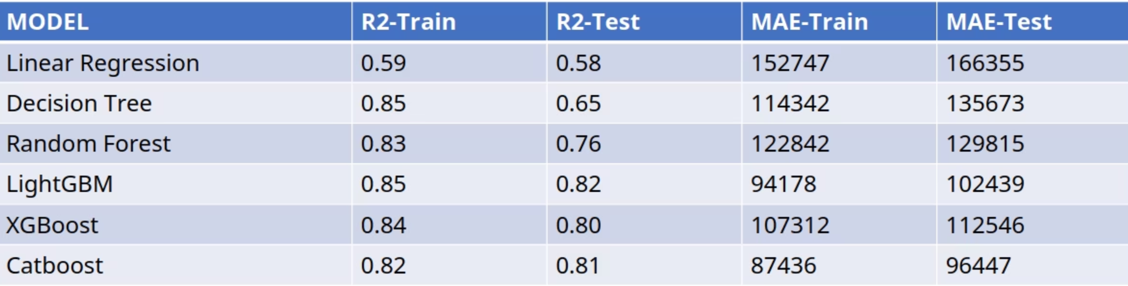
Results: Performance Metrics and Insights
81%
€96.4K
42%
R² Score
Mean Absolute Error
Error Reduction
CatBoost achieved the highest coefficient of determination.
Average deviation between predicted and actual prices.
Improvement over baseline linear regression model.
Notes:
This slide compares the performance of six machine learning models We evaluated each model using R², MAE on train and test data to understand both predictive power and error behavior Linear Regression Is Underpowered R² scores: 0.59 (train), 0.58 (test) MAE: much higher than any other model It underfits both training and test data, failing to capture complex patterns. This highlights the need for non-linear models for better performance on real-world price data. Tree-based models outperform linear models

Slide 4

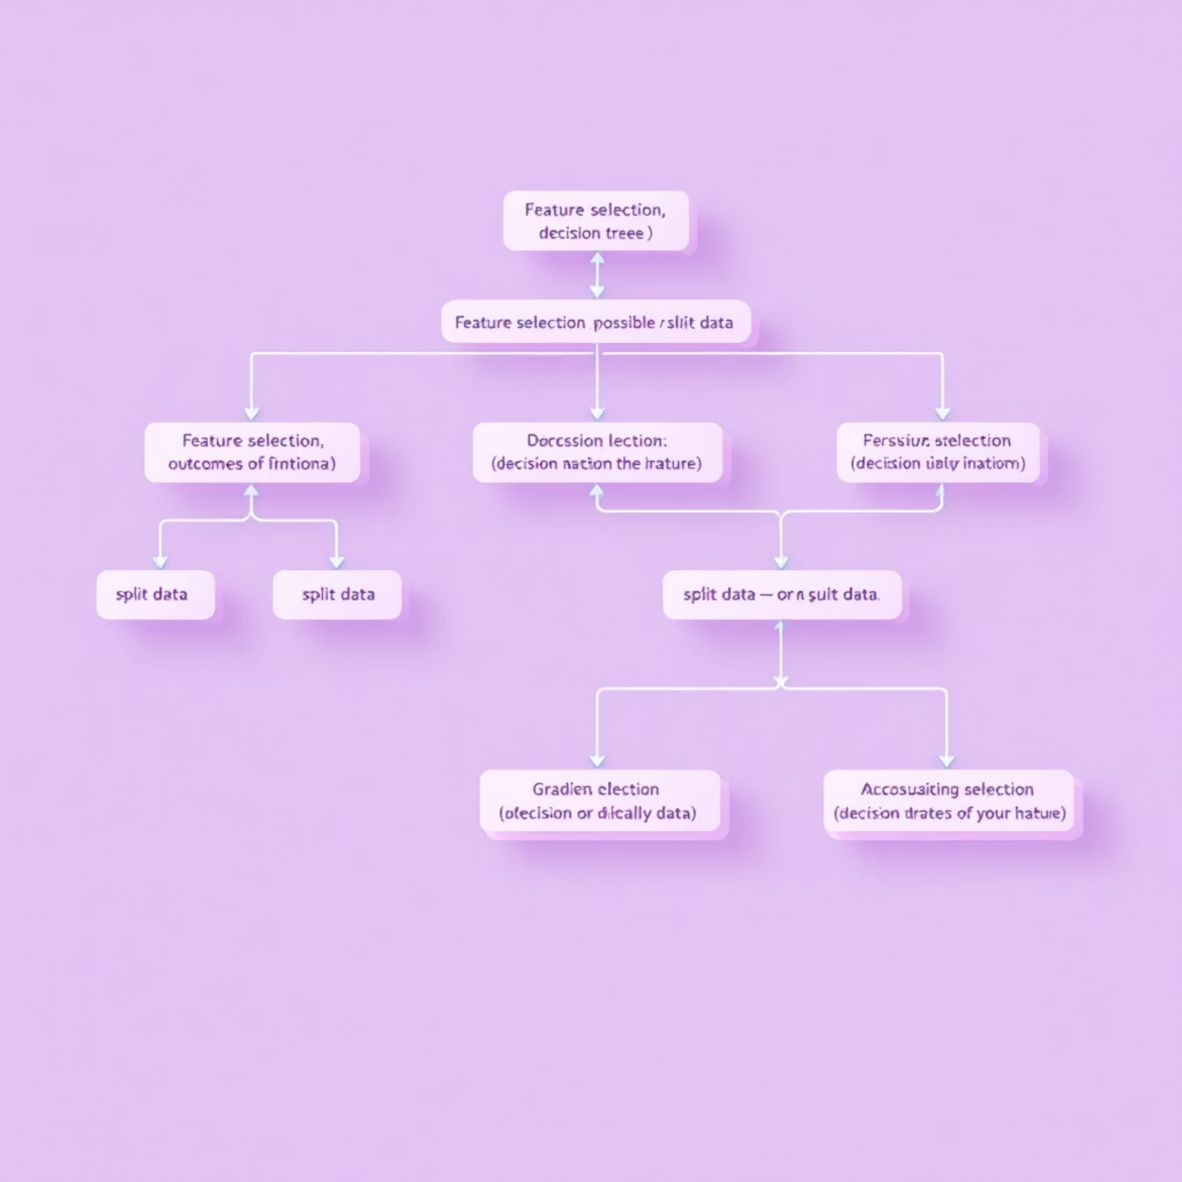


How CatBoost Works: Our Technical Approach
Introduction
Boosting algorithm
Creates multiple Trees
takes weighted sum
How it handles categorical features
CatBoost uses target statistics – converting categories into numbers based on the average target value.
To avoid target leakage, it uses a technique called ordered target encoding, which only uses past data when calculating statistics for each example.
Advantages of Catboost
No need for heavy preprocessing
requires minimal tuning
Robust to Overfitting:(Especially in small datasets)
CatBoost's ordered boosting technique helps prevent target leakage and reduces prediction shift, resulting in more stable real estate valuations.

Slide 5




Challenges
Data Quality Challenges
Model Tuning
Memory error

Slide 6

Thank You!

